Slide 1
Chapter 10:
Classes and Data Abstraction
Part II

Slide 2
Objectives
  Learn about the abstract data type (ADT)
  Explore how classes are used to implement ADTs
  Become aware of the differences between a struct and a class
  Learn about information hiding
  Explore how information hiding is implemented in C++
  Learn about the static members of a class
C++ Programming: From Problem Analysis to Program Design, Seventh Edition

Slide 3
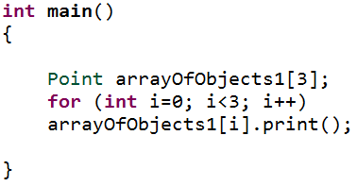

Arrays of Class Objects (Variables) and Constructors
If you declare an array of class objects, the class should have the default constructor
arrayOfObjects1[1]
arrayOfObjects1[0]
X
Y
arrayOfObjects1[1]
0
0
arrayOfObjects1[2]
C++ Programming: From Problem Analysis to Program Design, Seventh Edition

Slide 4
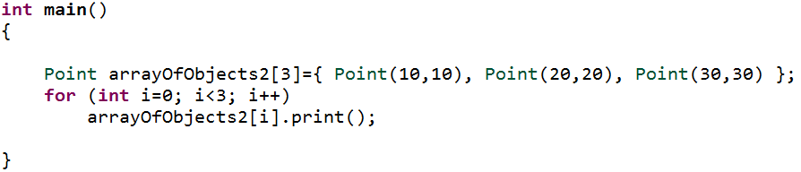

Arrays of Class Objects (Variables) and Constructors (cont’d.)
How to initialize array of objects?
OUTPUT
arrayOfObjects1[1]
arrayOfObjects1[0]
X
Y
arrayOfObjects1[1]
20
20
arrayOfObjects1[2]
C++ Programming: From Problem Analysis to Program Design, Seventh Edition

Slide 5
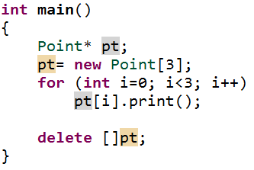

Arrays of Class Objects (Variables) and Constructors (cont’d.)
How to create dynamic array of objects?
OUTPUT
pt
Address of [0]
[1]
[0]
X
Y
[1]
0
0
[2]
C++ Programming: From Problem Analysis to Program Design, Seventh Edition

Slide 6
The “this” Pointer
“this” pointer is a predefined pointer that contains the address of the object referenced in the function call (current object)
Implicitly the compiler passes to the member function a hidden pointer of that object referenced in the function call
Implicitly the member function uses this hidden pointer to access a data member
C++ Programming: From Problem Analysis to Program Design, Seventh Edition

Slide 7
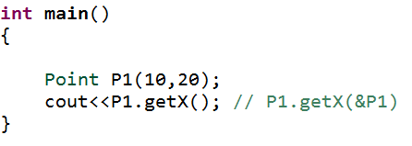
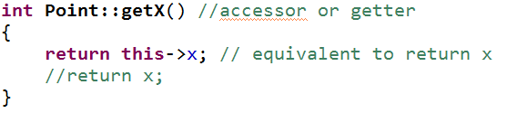
The “this” Pointer (cont’d.)
OUTPUT
C++ Programming: From Problem Analysis to Program Design, Seventh Edition

Slide 8
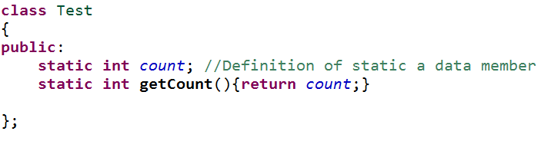
Static Members of a Class
There are two types of static class members
  Static data members
  Static member functions
C++ Programming: From Problem Analysis to Program Design, Seventh Edition

Slide 9
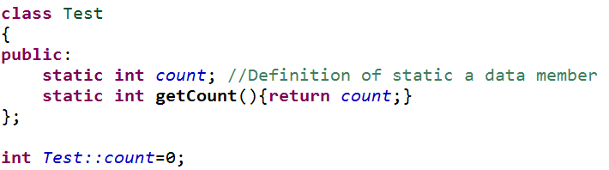
Static Members of a Class (cont’d.)
Static data members
Static data members must be declared outside the class as global data item.
  You may initialize it , otherwise it would be initialized to 0
  private, public and protected static data members must be declared outside the class
C++ Programming: From Problem Analysis to Program Design, Seventh Edition

Slide 10
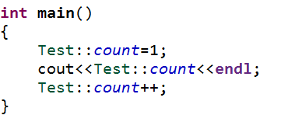
Static Members of a Class (cont’d.)
Static data members
Static data members exist independently of any class object
  You can access it using the class name and binary resolution operator (::) without object name (مهم)
  A static data member is a hybrid between a global variable and a data member belonging to a class (مهم)
OUTPUT
C++ Programming: From Problem Analysis to Program Design, Seventh Edition

Slide 11
Static Members of a Class (cont’d.)
Static data members
Multiple objects of a class each have their own copy of non-static member variables
All objects of a class share any static member of the class
C++ Programming: From Problem Analysis to Program Design, Seventh Edition

Slide 12
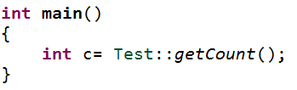
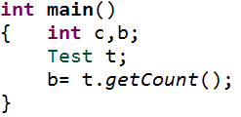
Static Members of a Class (cont’d.)
Static member functions
Static member functions are functions associated with a class not an object, and have the following characteristics:
  Client code can call these function using class name and (::)
  These function can directly access only static data members and static member functions belonging to that class
  These functions do not have “this” pointer (why?) مهم
Note: you can call a static member function using object name.
C++ Programming: From Problem Analysis to Program Design, Seventh Edition

Slide 13
Copy Constructor
A copy constructor is used to initialize a class object by using the values of an existing object of the same type (member-to-member copy)
Copy constructor is provided by the compiler
For classes with pointer member variables, the user must write the copy constructor:
C++ Programming: From Problem Analysis to Program Design, Seventh Edition

Slide 14
Copy Constructor (cont’d.)
A copy constructor automatically executes in three situations:
  When an object is declared and initialized by using the value of another object (مهم)
  When an object is passed by value as a parameter
  When the return value of a function is an object
C++ Programming: From Problem Analysis to Program Design, Seventh Edition

Slide 15
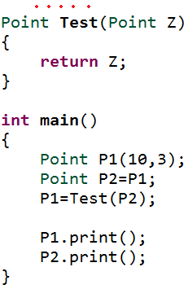
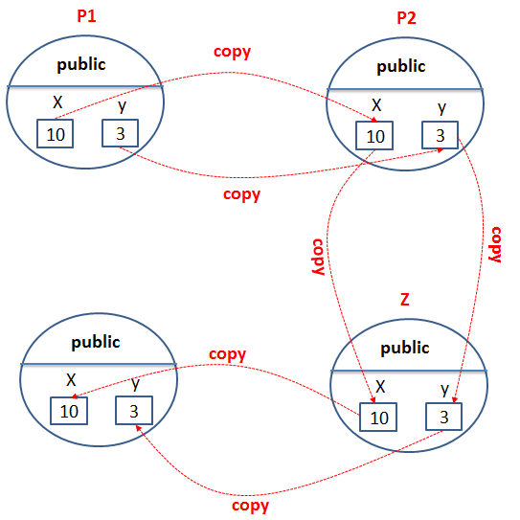

Copy Constructor (cont’d.)
OUTPUT
C++ Programming: From Problem Analysis to Program Design, Seventh Edition

Slide 16
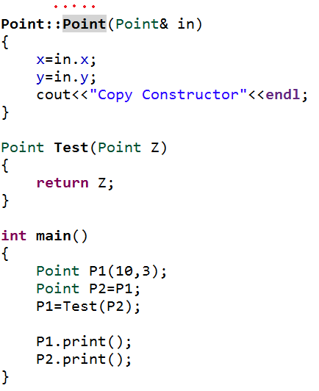
Copy Constructor (cont’d.)
OUTPUT
C++ Programming: From Problem Analysis to Program Design, Seventh Edition

Slide 17
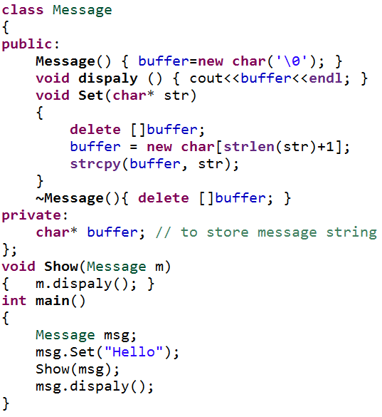
Copy Constructor (cont’d.)
msg
‘\0’
public
buffer
addr
H
e
l
l
o
m
OUTPUT
public
Hello
Runtime Error
buffer
addr
C++ Programming: From Problem Analysis to Program Design, Seventh Edition

Slide 18
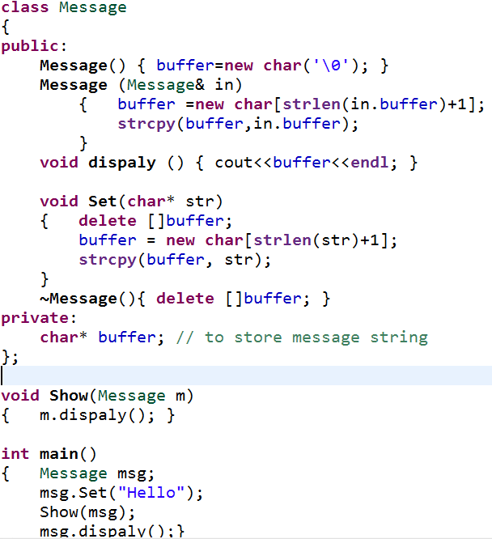
Copy Constructor (cont’d.)
msg
‘\0’
public
buffer
addr
H
e
l
l
o
m
public
OUTPUT
buffer
H
e
l
l
o
Hello
Hello
addr
C++ Programming: From Problem Analysis to Program Design, Seventh Edition

Slide 19
Copy Constructor by Nooralden
1 – copy Constructor is constractor recive a class object by reference and use assignment statement for get the value of sender object
2- يستدعى في ثلاث حالات مهمه
3 – if the class contain pointer member the syntax is : // Copy constructor
Point(const Point& other) { x = new int(*(other.x)); y = new int(*(other.y)); cout << "Copy constructor called" << endl; }
C++ Programming: From Problem Analysis to Program Design, Seventh Edition

Slide 20
Data Abstract, Classes, and Abstract Data Types
Abstraction
  Separating design details from usage
  Separating the logical properties from the implementation details
Abstraction can also be applied to data
Abstract data type (ADT): data type that separates the logical properties from the implementation details
C++ Programming: From Problem Analysis to Program Design, Seventh Edition

Slide 21
A struct Versus a class
By default, members of a struct are public
  private specifier can be used in a struct to make a member private
By default, the members of a class are private
classes and structs have the same capabilities
C++ Programming: From Problem Analysis to Program Design, Seventh Edition

Slide 22
A struct Versus a class (cont’d.)
In C++, the definition of a struct was expanded to include member functions, constructors, and destructors
If all member variables of a class are public and there are no member functions
  Use a struct
C++ Programming: From Problem Analysis to Program Design, Seventh Edition

Slide 23
The End
C++ Programming: From Problem Analysis to Program Design, Seventh Edition

